Slide 1
Kyiv - the capital of Ukraine
The presentation was prepared by:
Saveliev A. A., Dean of the Educational Institute of Foreign Citizens Training
Kunitsyn M. V., Deputy Dean of the Educational Institute of Foreign Citizens Training

Slide 2
Kyiv - the capital of Ukraine

Slide 3
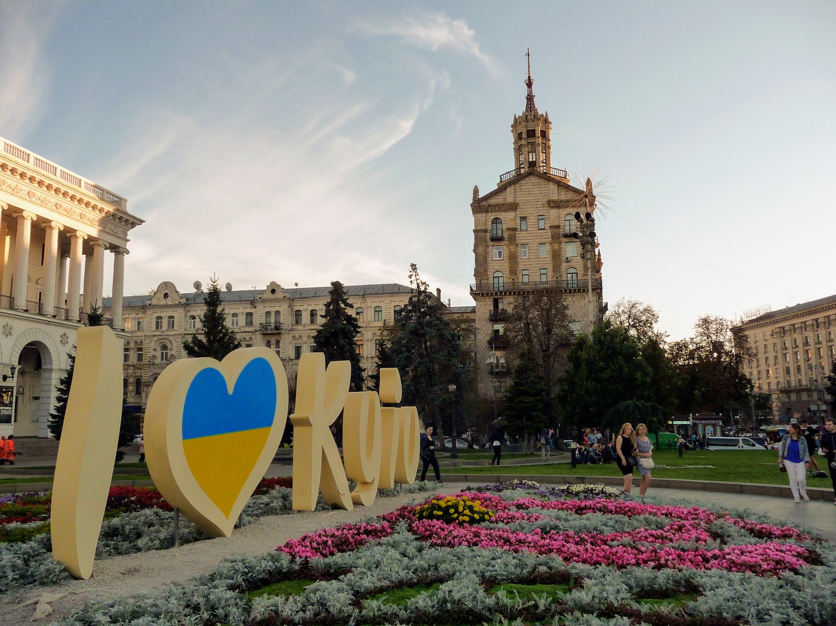
Kyiv - the capital of Ukraine
Kyiv is located on the hills, on the banks of the Dnieper River. It is one of the most beautiful cities not only in Ukraine but also in Europe. Kyiv is an ancient city. The date of its occurrence is 482. Therefore, Kyiv is 1538 years old.

Slide 4
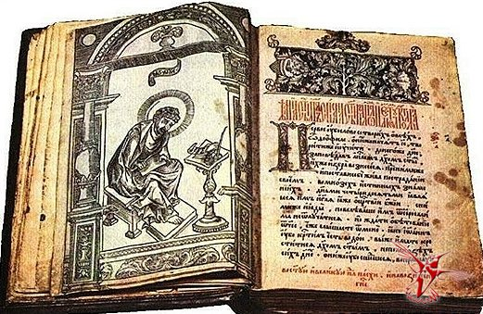
Chronicle - an ancient book
In the ancient Chronicle "The Tale of bygone years," there is a legend about the foundation of Kyiv.

Slide 5
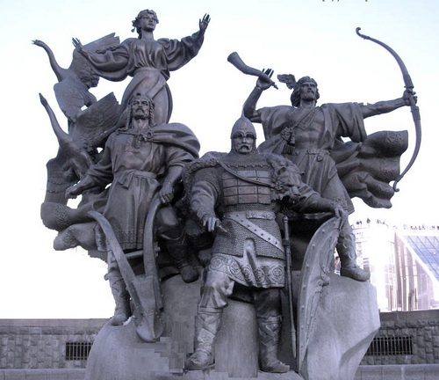
Legend of the foundation of the city of Kiev
Key, Shchek, Horiv, and their sister Lybid settled on the mountains above the Dnieper. The brothers built a city and named it Kyiv, that is, the city of Kiya, in the name of their older brother.

Slide 6
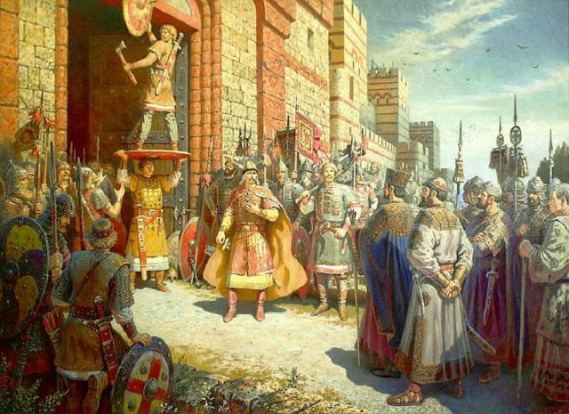
In 882, Kyiv became the capital of the state of Kievan Rus, which in the IX-XI centuries was the largest state in Europe.

Slide 7
Ancient architectural monuments of Kievan Rus

Slide 8
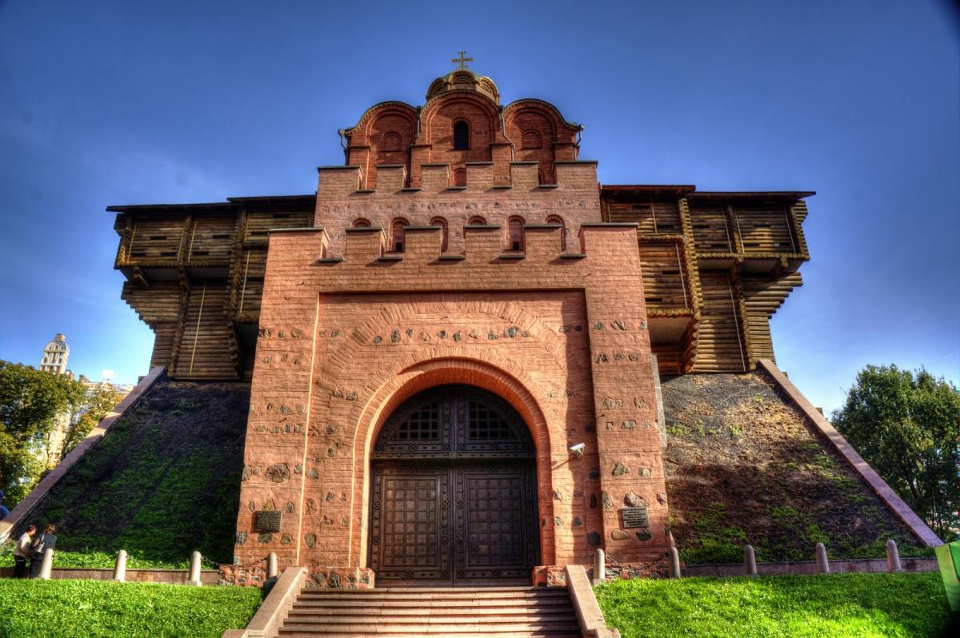
The Golden Gate
The Golden Gate was the main entrance to the city. They were built in 1037. At the top was a Christian Church. It was created so that everyone knew that Kyiv was a Christian city in Russia. There were more than 400 churches in the town.

Slide 9
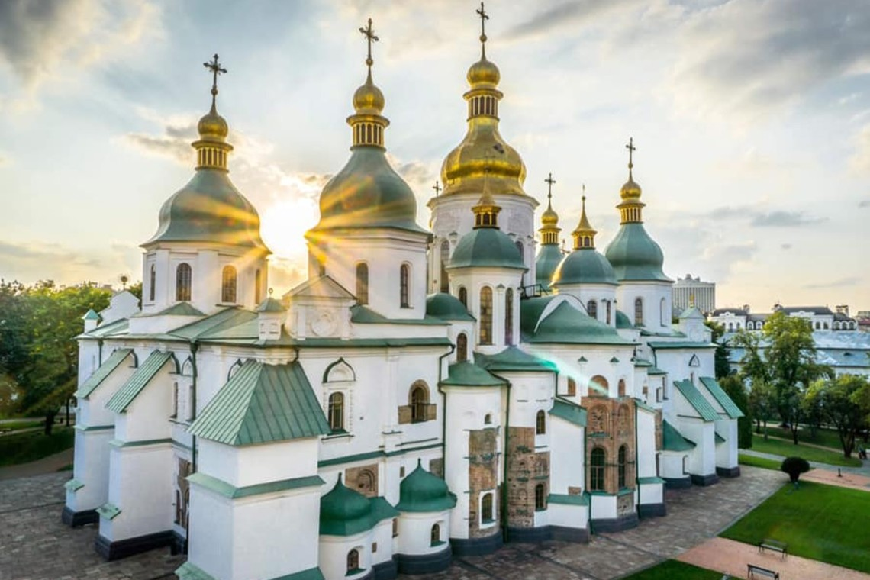
St. Sophia Cathedral
St. Sophia Cathedral is the oldest church. It was built in the XI century. In 1037, the cathedral opened the first library in Kievan Rus.

Slide 10
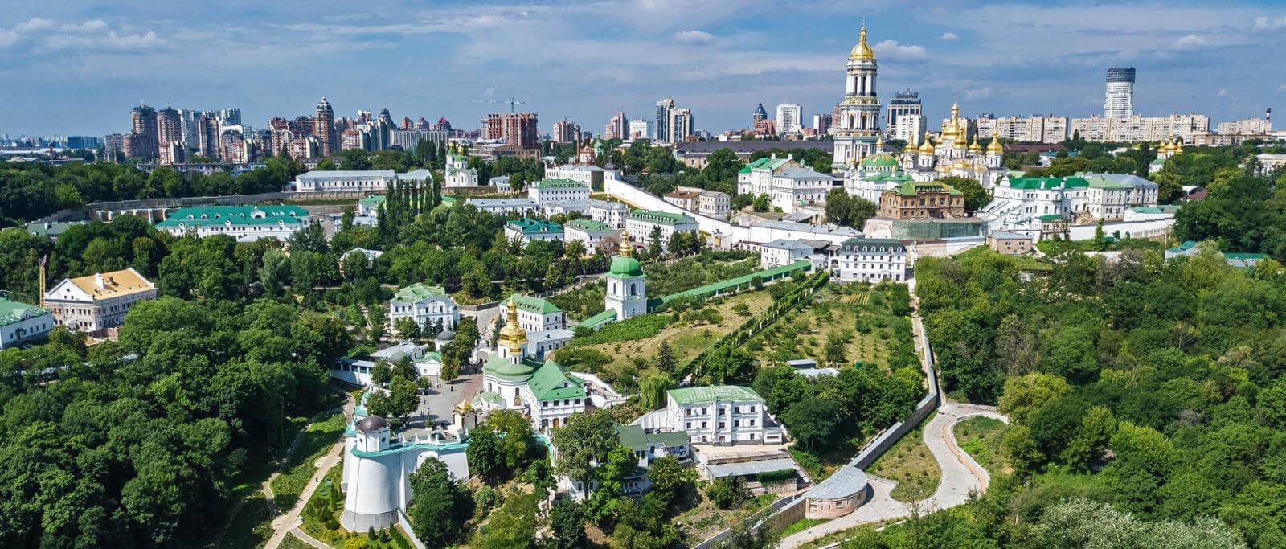
Kyiv-Pechersk Lavra
On the high hills above the Dnieper River is located Kyiv-Pechersk Lavra.

Slide 11
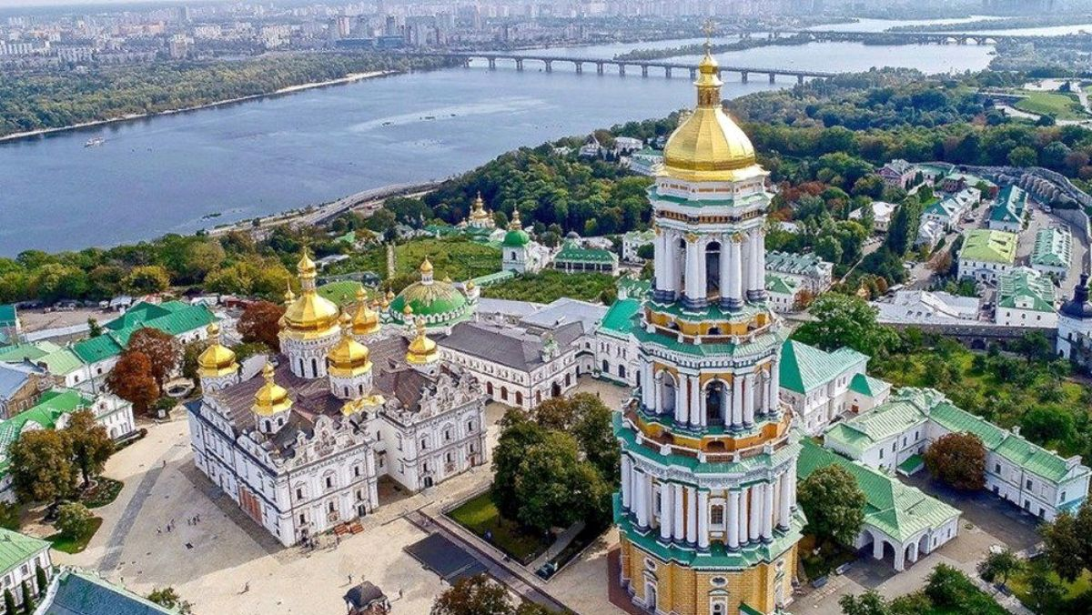
Kyiv-Pechersk Lavra
The Kyiv-Pechersk Lavra was a spiritual, cultural, and educational center because schools, libraries were opened here, chroniclers and icon painters worked, translators translated foreign books into old Slavonic.
The Kyiv Pechersk Lavra was founded in 1051.
The founders of the Kyiv Pechersk Lavra are Monk Anthony and his disciple Theodosius.

Slide 12
Ancient Kyiv - International Shopping Center

Slide 13
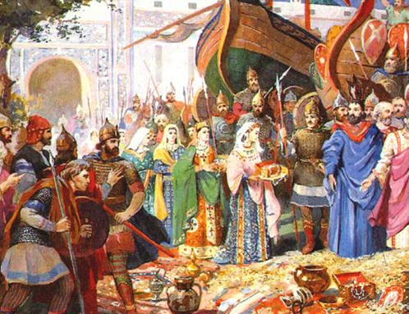
Ancient Kyiv - International Shopping Center
Kyiv traded with the countries of Central Asia, the northern Black Sea region, the Caucasus, Iran, and Byzantium. The proverb "The language will bring you to Kyiv" has been preserved to this day. It says that the main trade routes led to the city.
On the territory of modern Kyiv, archaeologists have found Arab and Byzantine coins, coins of the ancient cities of Kafa, Bukhara, Damascus, Samarkand, Baghdad, gold and silver jewelry from Eastern countries.

Slide 14
Modern Kiev

Slide 15
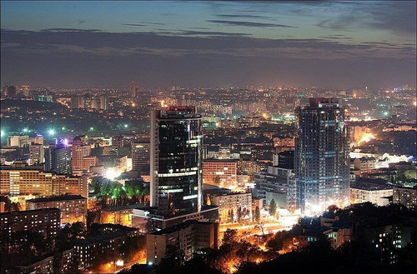
Modern Kiev
Modern Kyiv is a vast city. Its area is 836 square kilometers. The population of Kyiv is about 3 million people.

Slide 16
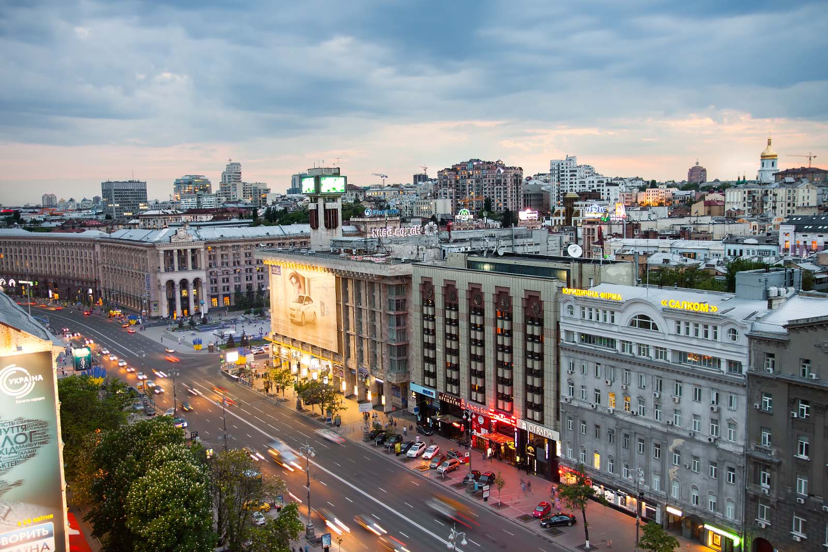
Khreshchatyk street
The main street of Kyiv is Khreshchatyk. It is approximately 150 years old.
Khreshchatyk is a business card of Kyiv. Khreshchatyk is the most crowded street.

Slide 17
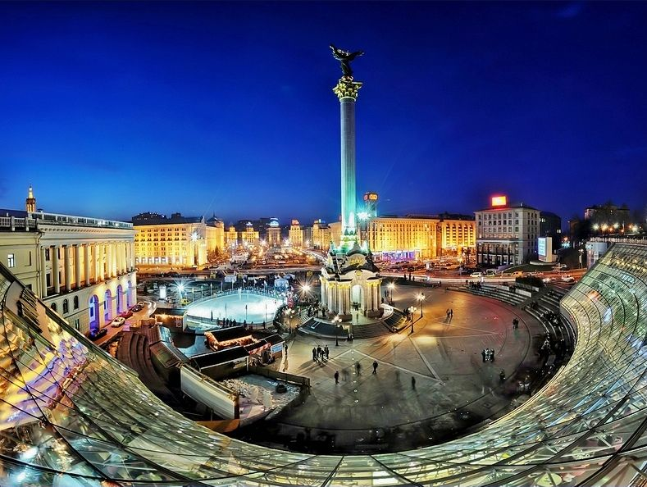
Independence Square
The most beautiful square in Kyiv is Independence Square. It is a traditional place where festivals, concerts, and festivities take place.

Slide 18
Kyiv - the center of Culture, Science, and Education

Slide 19
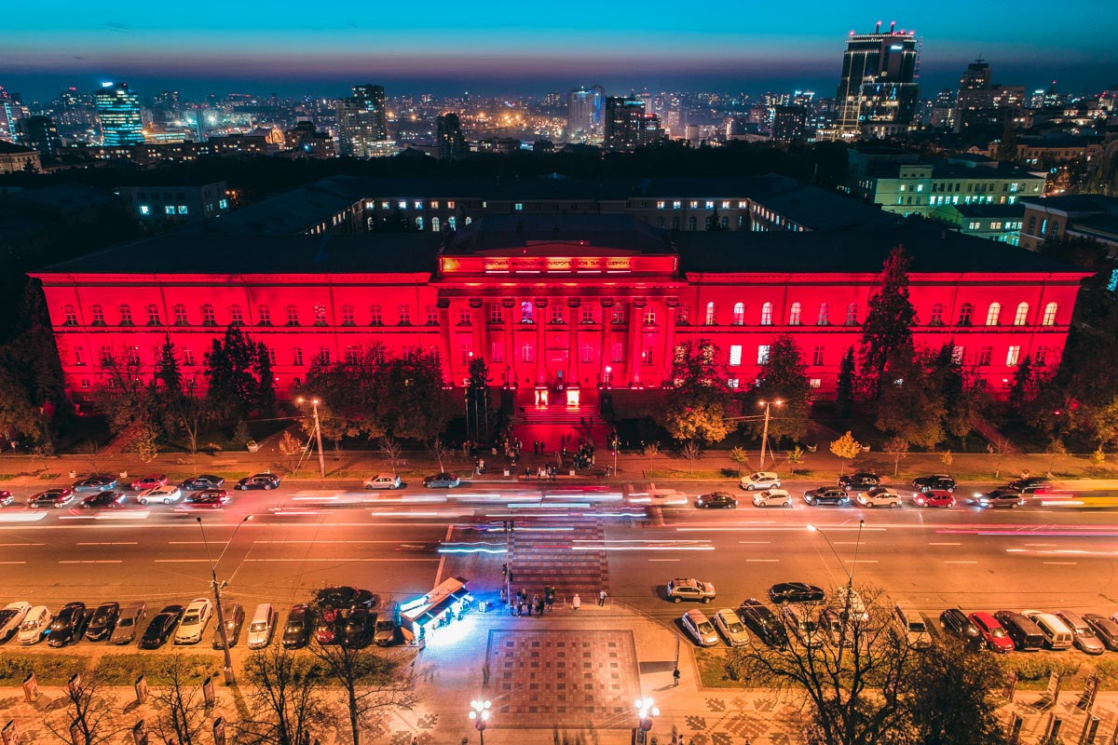
Kyiv - the center of Culture, Science, and Education
Kyiv is a center of Culture, Science, and education. There are 98 universities in the city, so we can say that Kyiv is a student city. In addition, the capital has 68 museums, 116 cinemas, and three film studios.

Slide 20
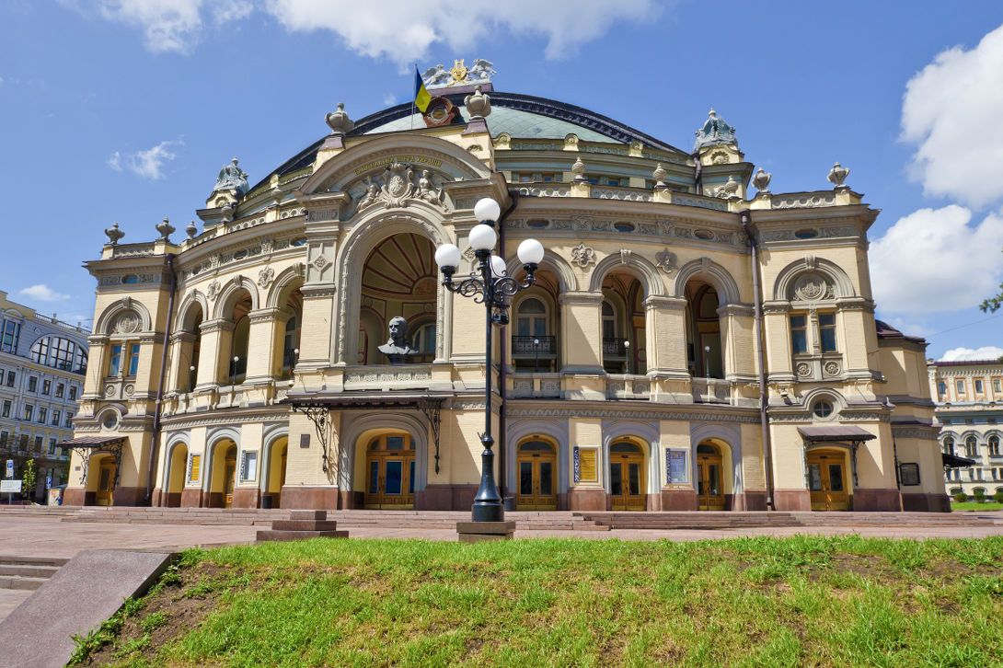
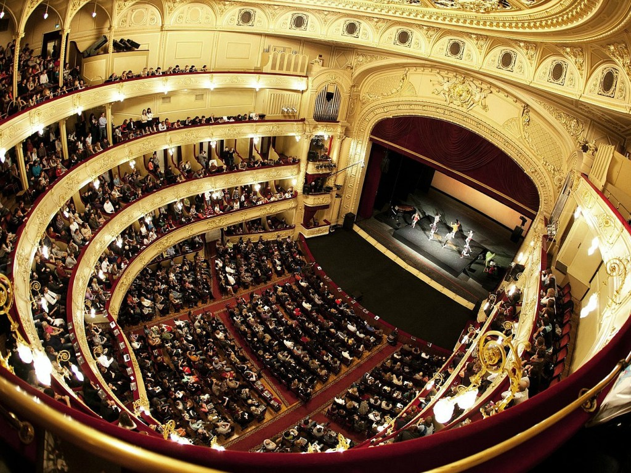
Taras Shevchenko Kyiv Opera and Ballet Theatre
The Taras Shevchenko Kyiv Opera and Ballet Theater is known all over the world.
In general, there are 33 theaters in Kyiv.

Slide 21
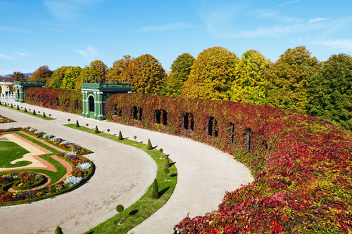
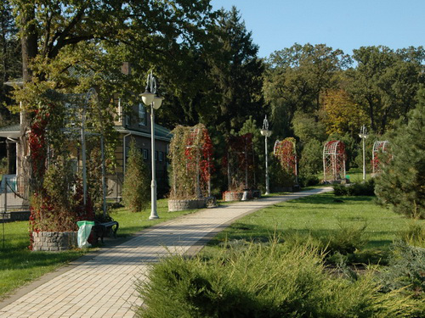
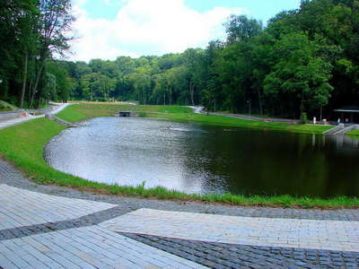
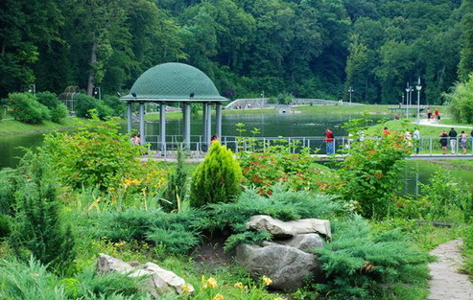
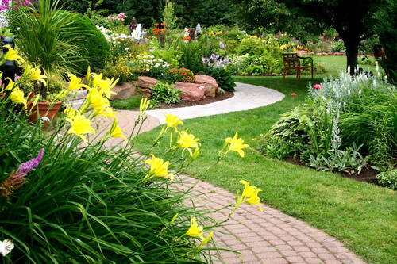
Kyiv - city of parks
There are 60 parks in Kyiv.

Slide 22
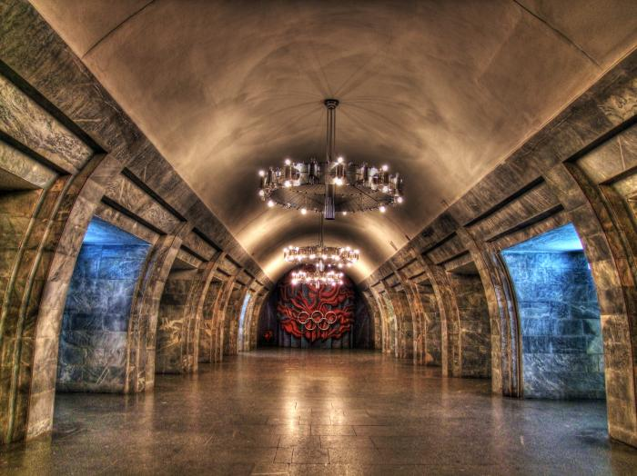
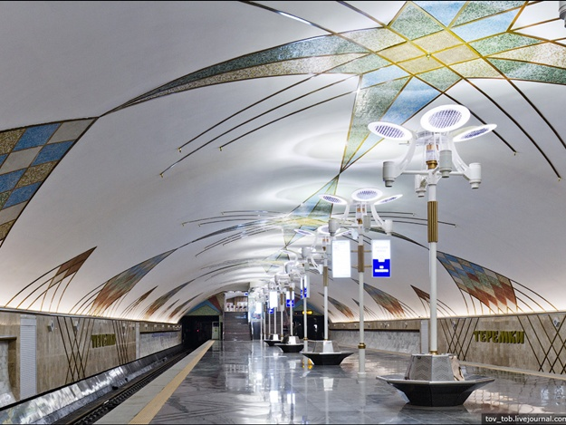
Kyiv Metro
The Kyiv Metro is the most convenient and cheapest form of transport. The Metro opened on November 6, 1960. Currently, there are 52 stations in the Metro. Their length is 69,648 kilometers.
The Metro transports 1 million 330 thousand passengers and 485 million 690 thousand in one day in a year.

Slide 23
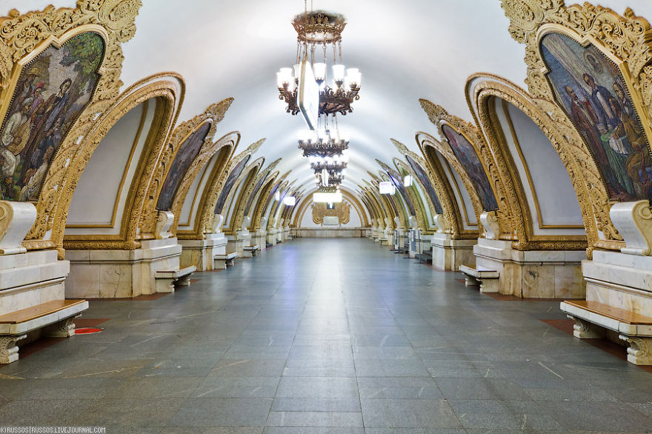
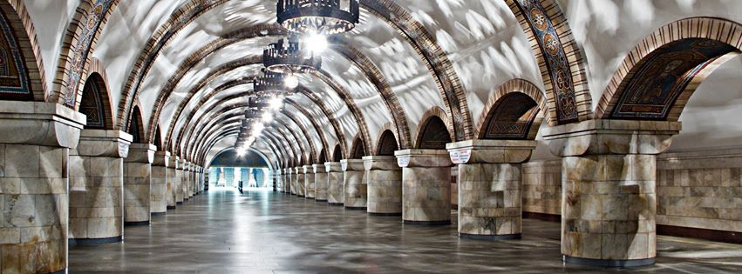
Kyiv Metro
The Kyiv Metro has a gorgeous design. In 2012, the Golden Gate station was included in the 22 most beautiful metro stations in Europe (according to the British newspaper Daily Telegraph).

Slide 24
THANKS
Does anyone have any questions?
Follow Us on Social Media
dec.ipig@opu.ua
opu.ua
fspirki.opu.ua
facebook.com/IPIG.ONPU
Project manager: lebedmy@gmail.com
The presentation was prepared by:
Saveliev A. A., Dean of the Educational Institute of Foreign Citizens Training
Kunitsyn M. V., Deputy Dean of the Educational Institute of Foreign Citizens Training

